Slide 1
What is Data Science? and Open Source tools for Data Science
BY
Udit kumar das

Slide 2
What is Data Science?
Data Science is a process, not an event.
It is the process of using data to understand different things, to understand the world
Data science is the art of uncovering the insights and trends that are hiding behind data.
Data science is a field about processes and systems to extract data from various forms of whether it is unstructured or structured form.
Data science is the field of exploring, manipulating, and analyzing data, and using data to answer questions or make recommendations.

Slide 3
Advice for New Data Scientists
data scientist is to be curious, extremely argumentative and judgmental.
Curiosity is absolute must. If you're not curious, you would not know what to do with the data.
Judgmental because if you do not have preconceived notions about things you wouldn't know where to begin with.
Argumentative because if you can argument and if you can plead a case, at least you can start somewhere and then you learn from data and then you modify your assumptions and hypotheses and your data would help you learn.
The other thing that the data scientist would need is some comfort and flexibility with analytics platforms: some software, some computing platform

Slide 4
Contd..
The other thing that the data scientist would need is some comfort and flexibility with analytics platforms: some software, some computing platform
The most important thing is curiosity and the ability to take positions. Once you have done that, once you've analysed, then you've got some answers.
A data scientist should be a great story teller, Because if you don't tell a great story from it, your findings will remain hidden, remain buried, nobody would know.

Slide 5
Data Science Topics and Algorithms
Regression (cab example)
Data visualization
Artificial Neural Network
Nearest Neighbour

Slide 6
What is the cloud?
Cloud is a godsend for data scientists primarily because you take your data, take your information, and put it in the Cloud, put it in the central storage system.
It allows you to deploy the analytics and storage capacities of advanced machines that do not necessarily have to be your machine or your company's machine.
Think of it as you have some information, you can't store it, so you send it to storage space, let's call it Cloud. And the algorithms that you need to use, you don't have them with you. But then, on the Cloud, you have those algorithms available. So, what you do is you deploy those algorithms on very large data sets and you're able to do it even though your own systems, your own machines, your own computing environment would not allow you to do so.

Slide 7
Contd..
Cloud is beautiful for is that it allows multiple entities to work with same data at the same time. So, you can be working with the same data that your colleagues in.
They are collectively working and they're able to do so because the information, and the algorithms, and the tools, and the answers, and the results, whatever they needed is available at a central place which we call Cloud.
It allows you to bypass the physical limitations of your personal computer and the systems you are using.

Slide 8
Big Data
Big data is data that contains greater variety arriving in increasing volumes and with ever-higher velocity. This is known as the three Vs.
Big data is larger, more complex data sets, especially from new data sources.
These data sets are so voluminous that traditional data processing software just can’t manage them. But these massive volumes of data can be used to address business problems you wouldn’t have been able to tackle before.

Slide 9
The three Vs Of Big Data
Volume
Velocity
Variety

Slide 10
Hadoop
Hadoop is an open source distributed processing framework that manages data processing and storage for big data applications running in clustered systems.
Hadoop can handle various forms of structured and unstructured data, giving users more flexibility for collecting, processing and analysing data than relational databases and data warehouse provide.

Slide 11
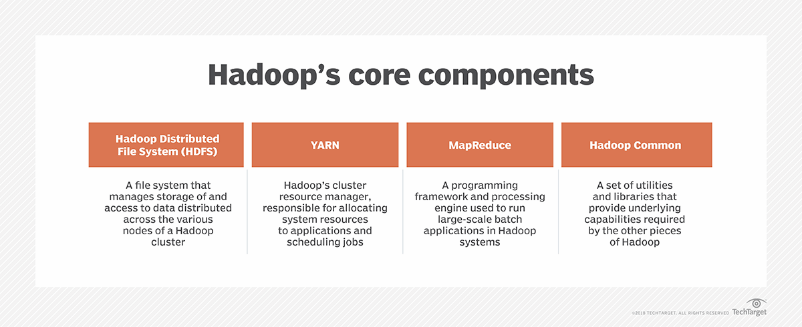
Hadoop’s Core Components

Slide 12
Data Mining
Data mining is the process of analysing hidden patterns of data according to different perspectives for categorization into useful information.

Slide 13
Steps of data mining
Selecting Data
Pre-processing Data
Transforming Data
Storing Data
Mining Data
Evaluating Mining Results

Slide 14
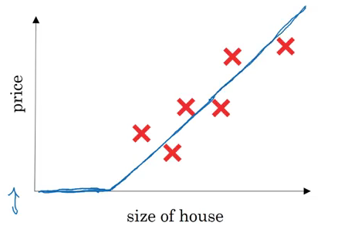
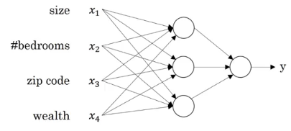
Neural Networks and Deep Learning

Slide 15
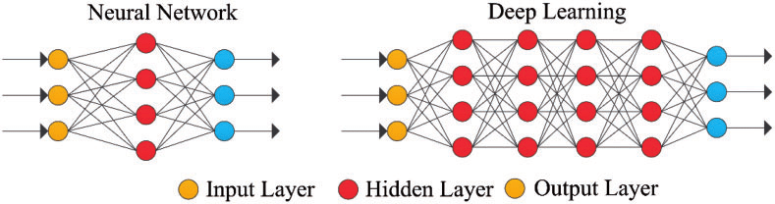
Contd..

Slide 16
Applications of Data Science
Internet Search
Speech Recognition
Advanced Image Recognition
Augmented Reality
Gaming
Recommendation System
Price Comparison Websites

Slide 17
Open Source tools for Data Science
Jupyter Notebook
Apache Zeppelin Notebooks
RStudio IDE
IBM Watson Studio

